Slide 1
IBM Capstone Project NY and London Neighbourhoods
Analysis of Neighborhoods for setting up chains of restaurants and cafes in London and New York

Slide 2
Problem Statement
New York and London are two of the biggest profile cities on the World
Setting up restaurant and café establishments in these cities would be costly but potentially very lucrative
Potential to give high global brand recognition
Where exactly to open these establishments, beyond the ‘centre of town’

Slide 3
Approach to the Problem
Foursquare (local venue information such as category)
Python
Categorise neighbourhoods into clusters based on establishment type density
Map cities and neighbourhoods based on cluster

Slide 4
Methodology
Data Sources – Web scraping (Beautiful Soup) public (Wikipedia) data to find names of neighbourhoods in NY and London
Find Geolocation Data for Neighbourhoods
Use neighbourhood locations with Foursquare API to find venue information of each venue
Data Cleaning
Change venue types so different types of restaurant are restaurant only
Data preparation – create a profile for each neighbourhood with numbers of each type of establishment

Slide 5
Methodology continued…
K means Clustering – creates 5 cluster centres form the data
Algorithm sorts the neighbourhoods into these clusters (Euclidean distance)
Define cluster centres in terms of number of key establishments
Group neighbourhoods for full list of similar neighbourhoods
Final report and recommendations

Slide 6
Results – Cluster Centres
Colour | Cluster | Characteristics
Red | Cluster 0 | lowest number of Restaurants
Purple | Cluster 1 | Highest number of Restaurants
Blue | Cluster 2 | medium number of restaurants, no real prevalence of any other type of venue
Light Blue | Cluster 3 | Second highest number of restaurants
Light Green | Cluster 4 | Second lowest number of restaurants
Orange | Cluster 5 | Medium number restaurant -, differentiated from Cluster 2 by having a significant number of cafes, pubs, and coffee shops

Slide 7
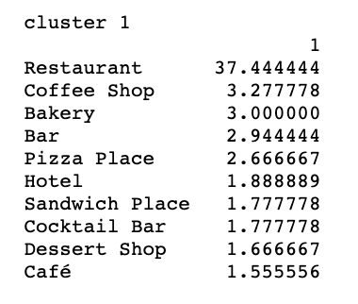
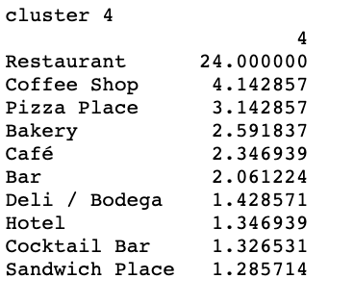
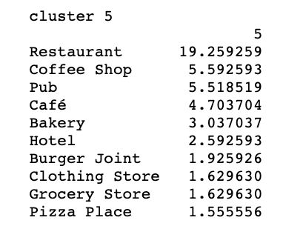
Results – Clusters of Interest
Purple - Cluster 1 - Highest number of Restaurants
Light Green - Cluster 4 - Second highest number of restaurants and high concentration of cafes and bars
Orange - Cluster 5 - Medium number restaurants and a good number of cafes and coffee shops
Cluster centre profiles (showing absolute numbers of each venue type):

Slide 8
Recommendations for further consideration
From London and New York

Slide 9
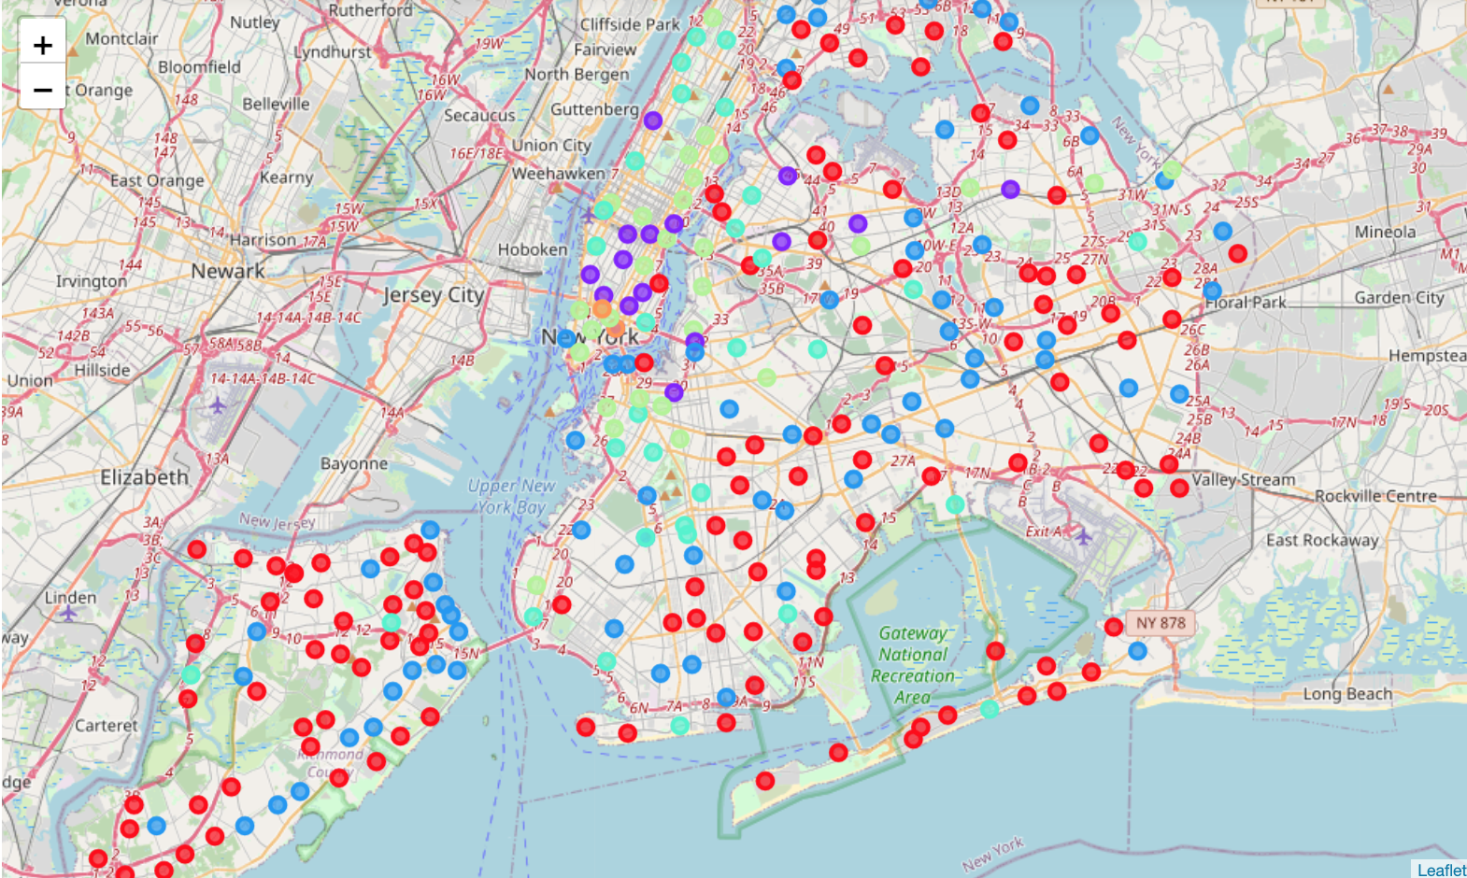
New York Neighbourhoods Map
Purple - Cluster 1 - Highest number of Restaurants
Light Green - Cluster 4 - Second highest number of restaurants and high concentration of cafes and bars
Orange - Cluster 5 - Medium number restaurants and a good number of cafes and coffee shops

Slide 10
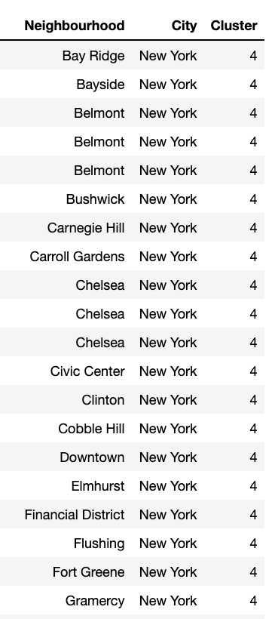
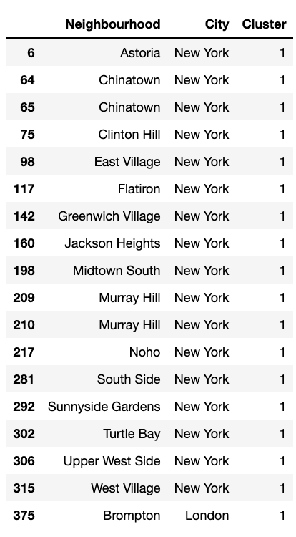
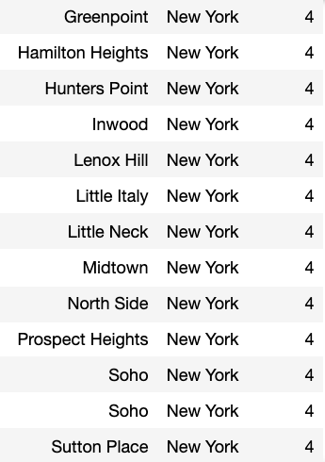
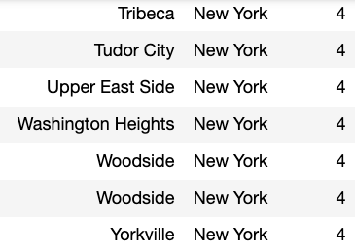
New York Neighbourhoods of Interest
Purple - Cluster 1 - Highest number of Restaurants
Light Green - Cluster 4 - Second highest number of restaurants and high concentration of cafes and bars
Orange - Cluster 5 - Medium number restaurants and a good number of cafes and coffee shops

Slide 11
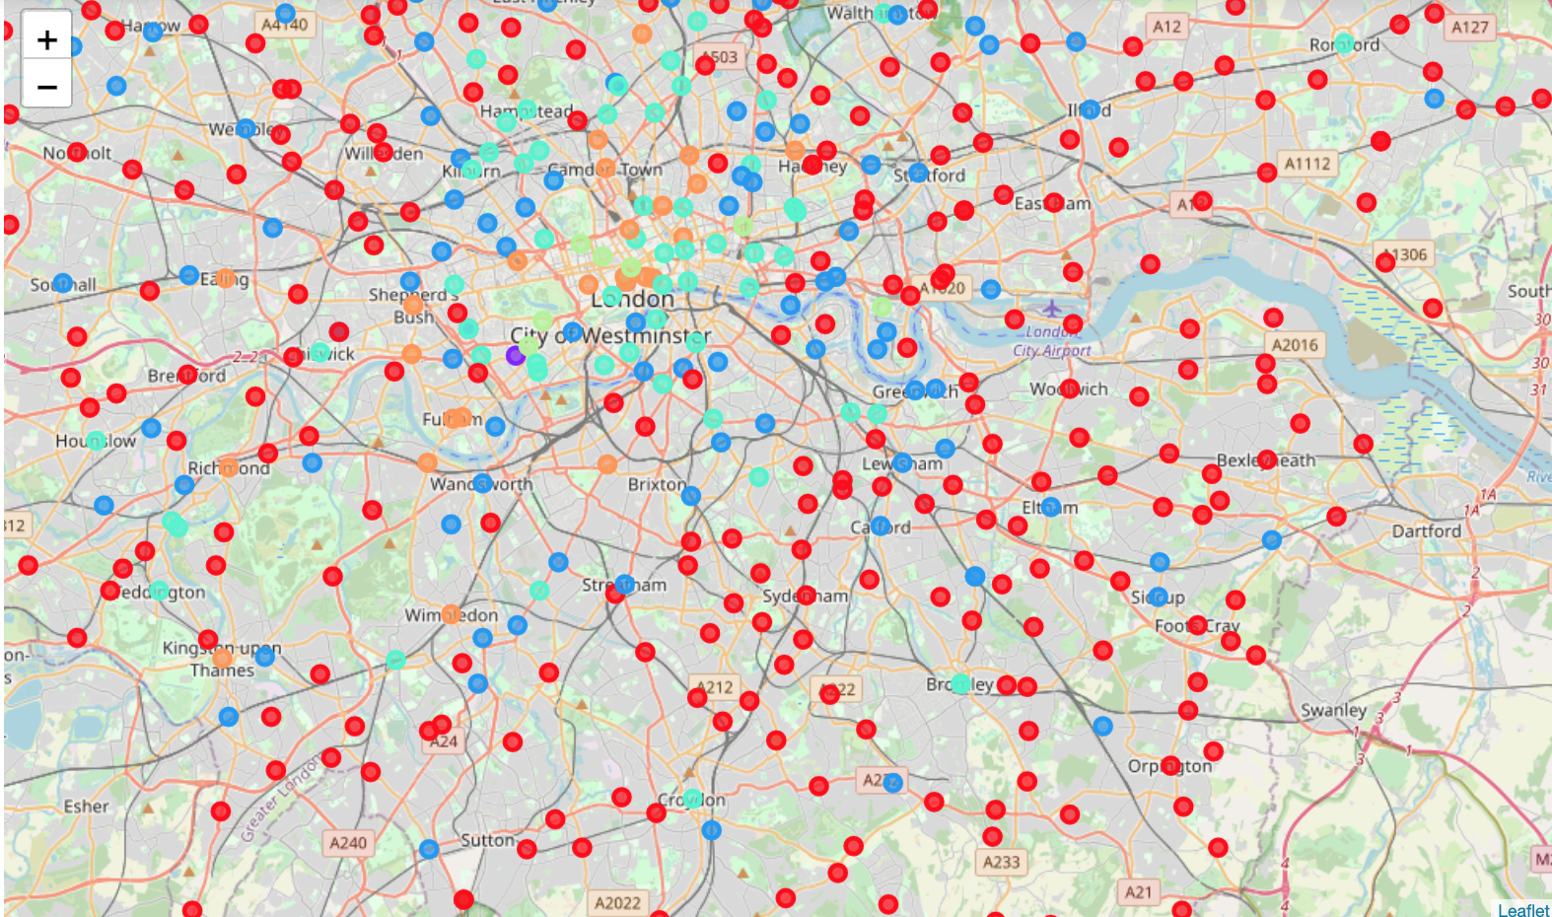
London Neighbourhoods Map
Purple - Cluster 1 - Highest number of Restaurants
Light Green - Cluster 4 - Second highest number of restaurants and high concentration of cafes and bars
Orange - Cluster 5 - Medium number restaurants and a good number of cafes and coffee shops

Slide 12
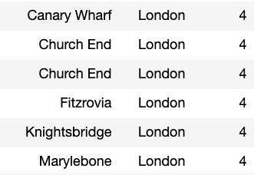
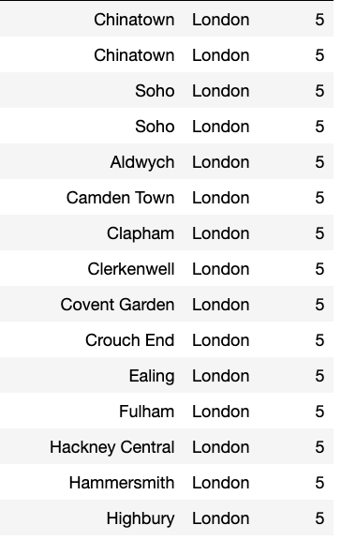
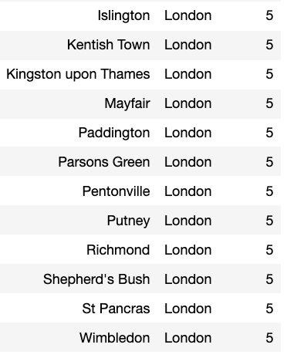
London Neighbourhoods of Interest
Purple - Cluster 1 - Highest number of Restaurants
Light Green - Cluster 4 - Second highest number of restaurants and high concentration of cafes and bars
Orange - Cluster 5 - Medium number restaurants and a good number of cafes and coffee shops

Slide 13
Conclusions
London has very few neighborhoods in cluster 1
New York has zero neighbourhoods in cluster 5
New York might be better suited for opening restaurant chain whilst London may be better for Café chain
Potential difficulty in analysis due to category types which might need better standardization
Pubs and bars are the same thing but due to cultural differences, are classed differently

